Slide 1
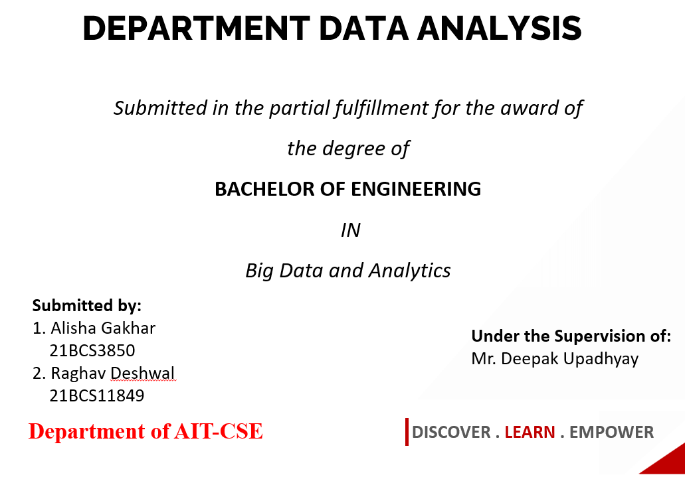

Slide 2



INTRODUCTION
The Departmental Data Analysis project will roll out managerial software to digitize the management of departmental data such as employee/faculty/student information, E-notices, Attendance Management, etc which, otherwise, would need to be done in conventional on-paper methods.
This analysis aims to gain insights into the department's operations and identify areas for improvement. This can involve identifying data trends, patterns, and correlations to inform strategic initiative decisions.
The main operation is to analyze attendance. Modernizing the traditional attendance system is important because paper-based systems can be time-consuming and error-prone.

Slide 3

Many organizations have large amounts of departmental data that could be used to inform decision-making and drive business growth. However, analysing and interpreting this data can be complex and time-consuming task, especially when dealing with multiple departments within an organization. The lack of an efficient data analysis process can lead to mislead opportunities, ineffective decision-making, and ultimately, a decrease in productivity and revenue. Therefore, the problem statement is how to develop an efficient and effective departmental data analysis process that enables organizations to leverage their data to make informed decisions, improve performance, and achieve their analysis goals. This process should consider the various data sources, the complexity of the data, and the different departmental needs while also ensuring data accuracy, consistency, and privacy.

Slide 4

Modernizing the traditional attendance system can address these issues and provide the following range of benefits:
Define the objective Identify the data sources Collect the data Analyze the data Interpret the results
Communicate the findings Take action
Increased Accuracy: Modern attendance systems use digital technology to eliminate human error risk and ensure accurate record-keeping.
Greater Efficiency: These systems are more efficient than manual systems, as they can process attendance data more quickly and with less effort.
Cost Savings: It can reduce the need for manual data entry and eliminate the cost of paper-based systems, resulting in cost savings for the organization.
These benefits can contribute to a more productive and successful organization.

Slide 5
CONCLUSION
The departmental Data Analysis System is designed to support informed decision-making by providing valuable insights from various data sources. By following a defined data analysis process and implementing a data governance framework, this system can ensure the security and integrity of the data while providing accurate and timely information to support business goals. We propose a departmental data analysis system that may or may not have one or more of the following features. Attendance Management System, b.
Notices and information, c. Circulars and related data, d. Analysis of the departmental data, e. Tableau Dashboard. More over to preserve the traditional attendance system– We may also work on the traditional attendance methods and prepare a separate analysis for spam/fake/proxy attendance. The analysis may not only ensure that the attendance is safe but may also specify whether there is spam/proxy or not.

Slide 6
REFERENCES
GATETE Marcel, HARUBWIRA Flaubert, “A Development of an Online Student Attendance Management Information System: Case Study “University of Tourism, Technology, and Business Studies”,” International Journal of Scientific Research in Computer Science and Engineering, Vol.10, Issue.1, pp.32-48, 2022.
K.J.H.D. Asiri, K.S. Rishan, U.A. Hewage., U.K.T. Prasadika, K.A. Dilini T. Kulawansa “ Attendance Management System”,” 8th International Conference on Advances in Computing, Electronics and Communication – ACEC”
Ekhlas Ghaleb Abdulkadhim 2021 J. Phys.: Conf. Ser. 1804 012011
Abdoulrahmaine Mohammad, Mohammad Elmi Hassan, Muslim Musa -2020, “IUT DHAKA 123456789/92”
Mrs. Dhanashree Amit Gupta “ Student Attendance Software”,” IJSER VOLUME 2, ISSUE 11, NOVEMBER 2011”
S. Y. Inamdar1, Vishal V. Suryawanshi2 “Student Attendance System based on Data Analytics“, “IARJSET VOL. 4, Special Issue 4, January 2017”

